Slide 1
ccRCC Single-Cell Data Preview
Nick Borcherding
06/30/2020

Slide 2
Overview Analysis
Very basic presentation, looking for interesting trends
Colors, Naming Schemes, etc can all be change very easily
Avoided assigning immunology terms, like Th1 CD4+ Cells to prevent bias
Data
3 ccRCC patients with tumor and peripheral blood
Added controls:
1 healthy peripheral blood donor
3 normal kidney donors – filtered this data set for only immune cells

Slide 3
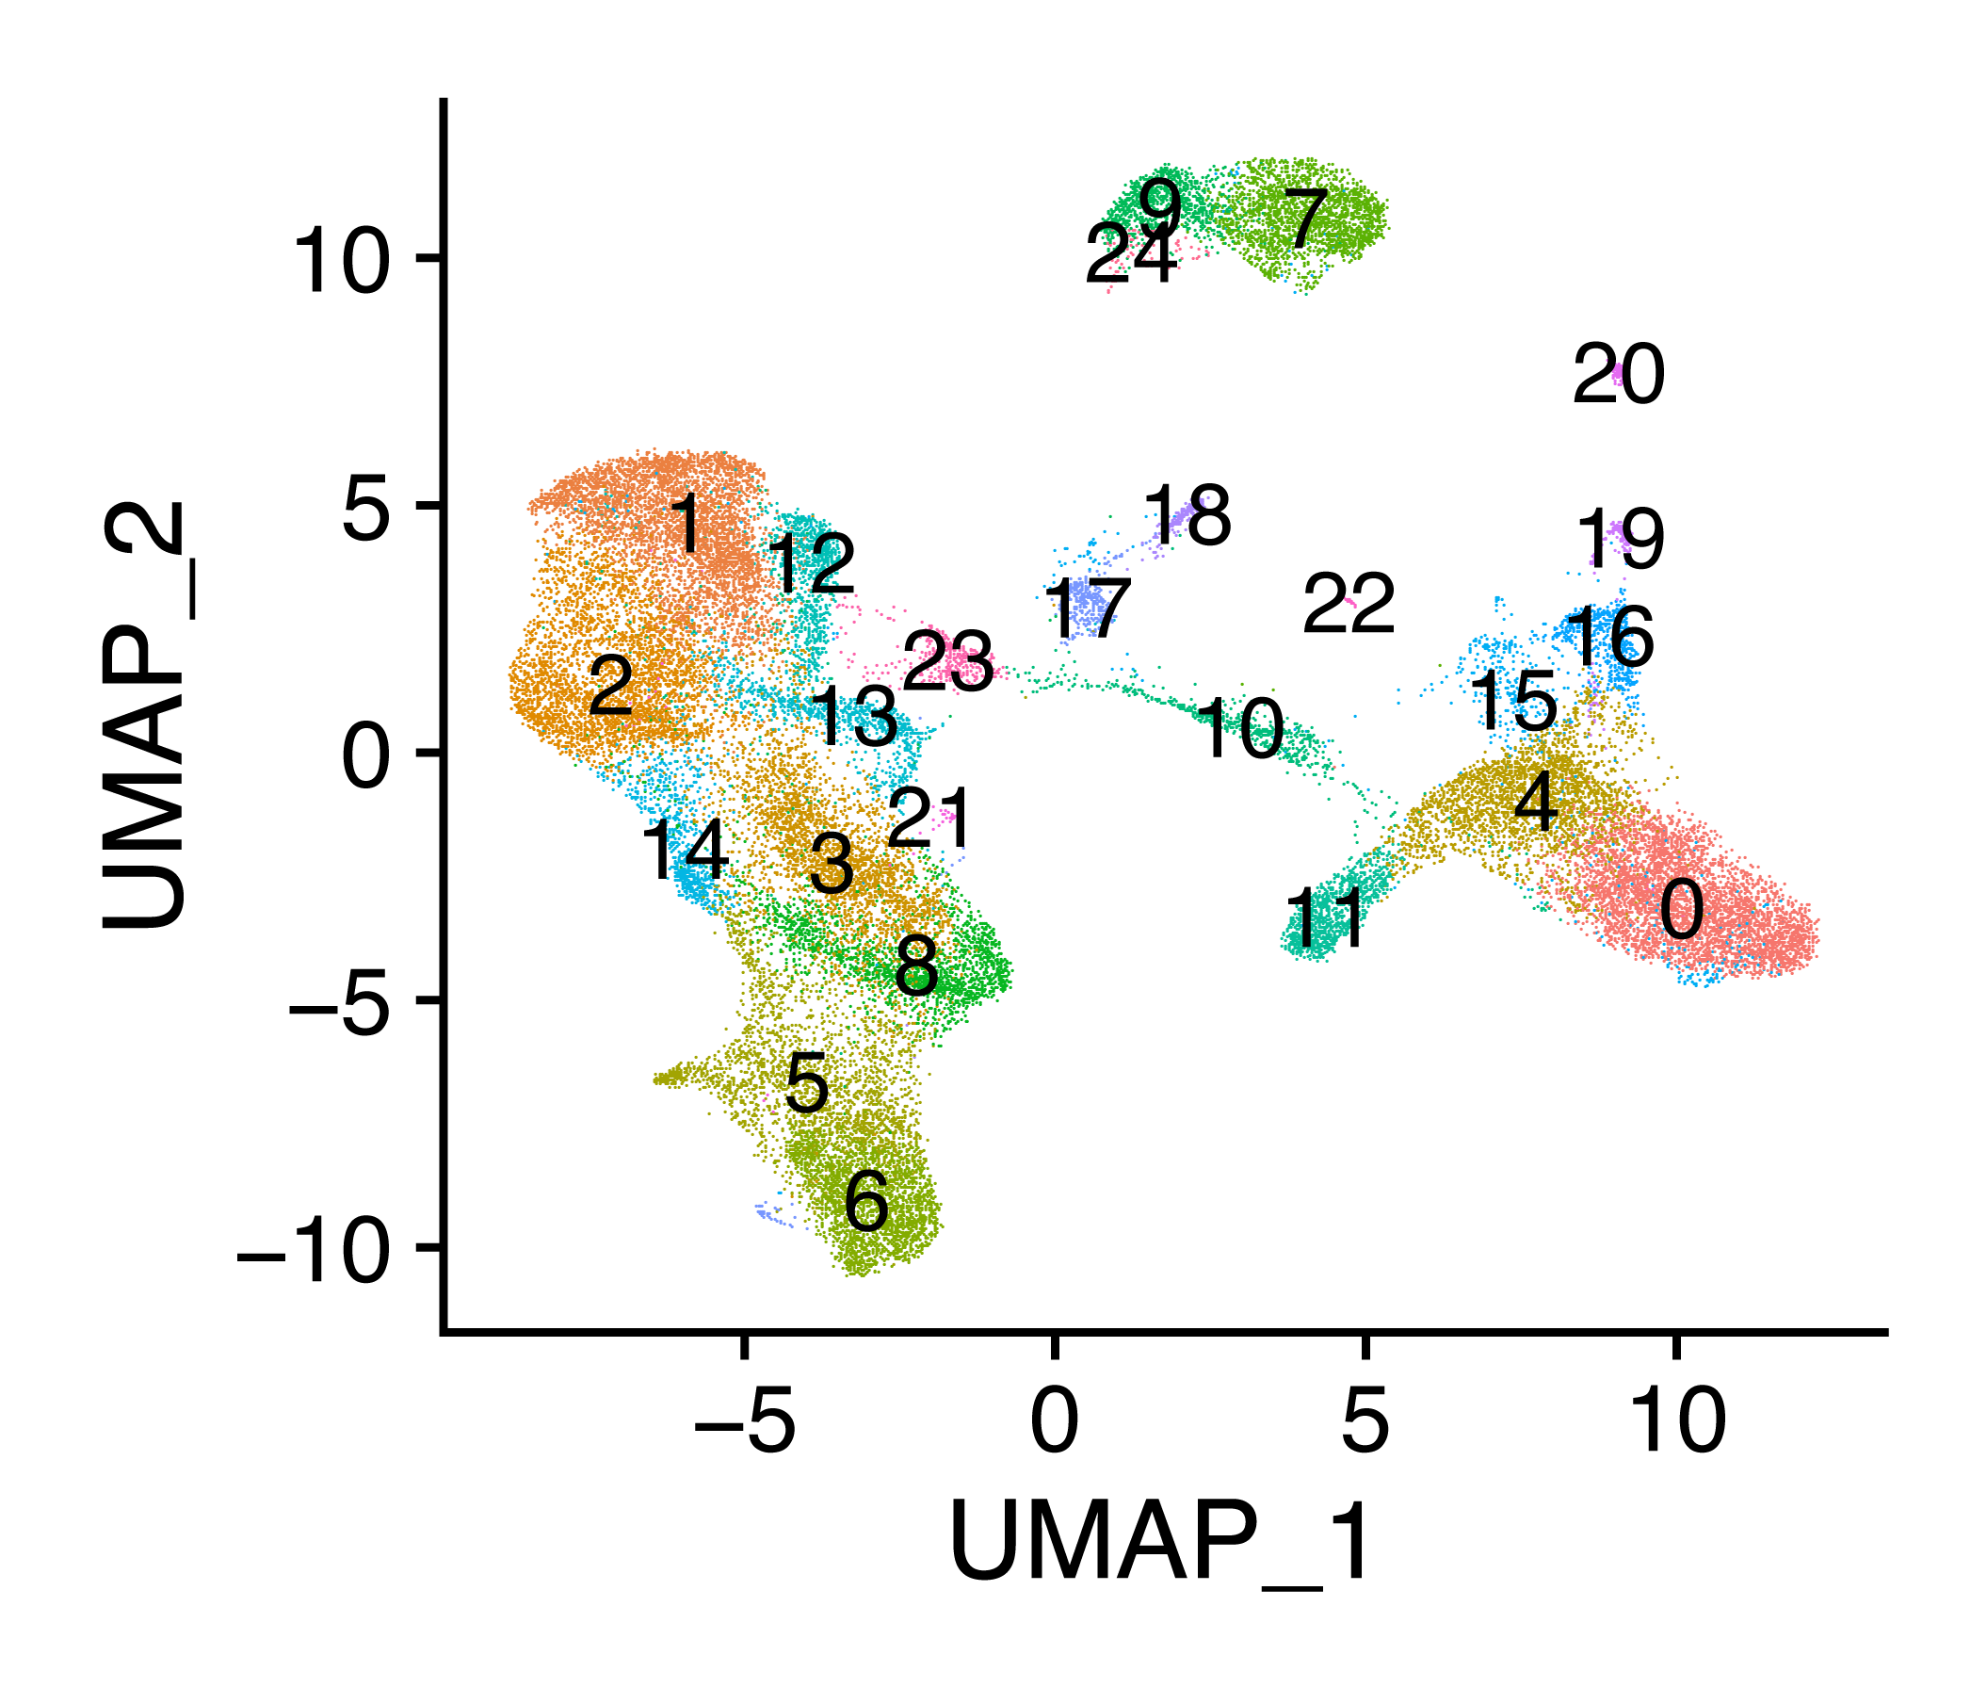
Sample | Tissue | Number of cells | Mean number of genes
N1 | P | 7726 | 1781
N2 | K | 890 | 987
N3 | K | 242 | 949
N4 | L | 646 | 652
P1 | P | 5820 | 1611
P1 | T | 4844 | 1947
P2 | P | 2459 | 1430
P2 | T | 2715 | 1785
P3 | P | 5125 | 1303
P3 | T | 4680 | 1995

Slide 4
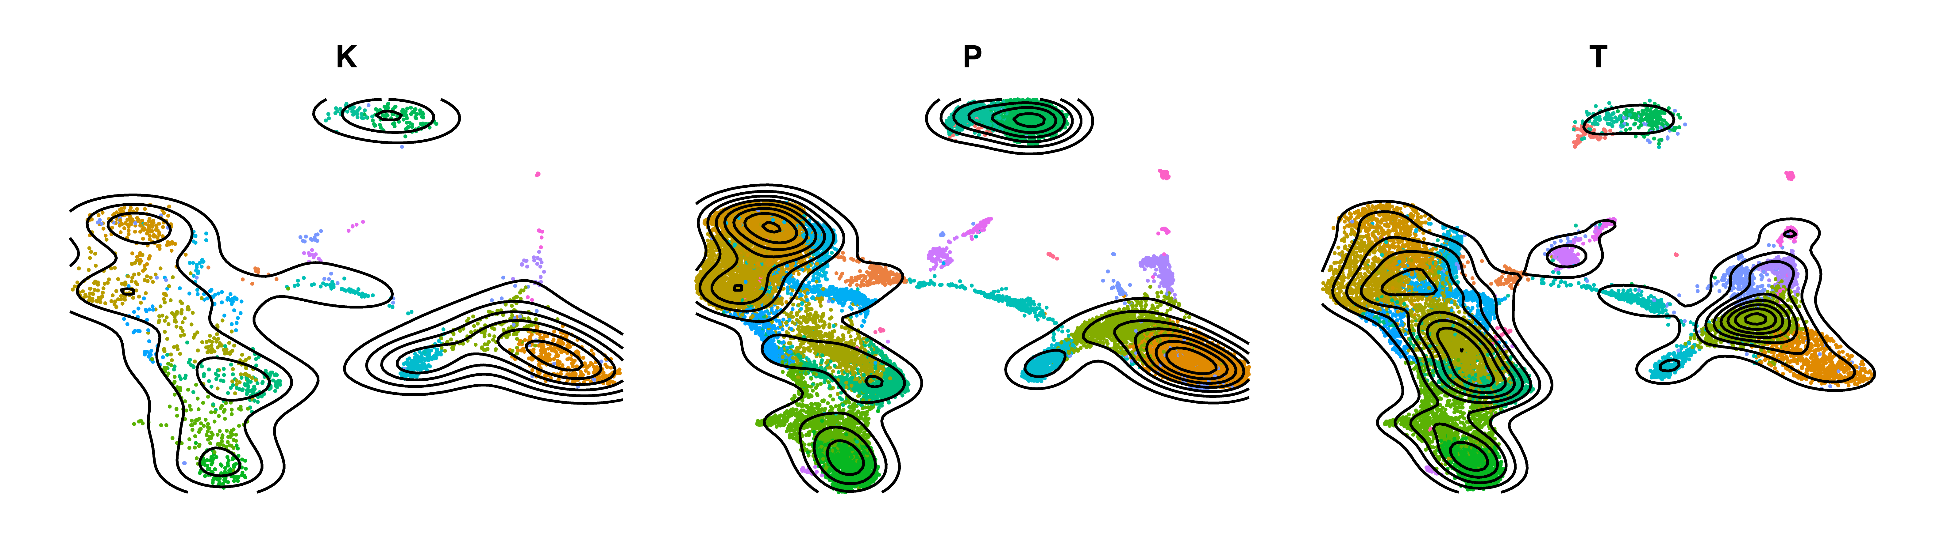
Distribution of cell by tissue
K = Kidney Parenchyma
P = Peripheral Blood
T = Tumor

Slide 5
Cell Type Identification
1. Use canonical Markers

Slide 6
B Cells
Dendritic
Expression is % of cell expressing gene

Slide 7
Myeloid

Slide 8
NK Cells
T Cells

Slide 9
Cell Type Identification
2. Use Correlations with pure cell populations from ENCODE

Slide 10
Correlations with Pure Cell Populations

Slide 11
Cell Type Identification
3. Attach TCR contig data

Slide 12
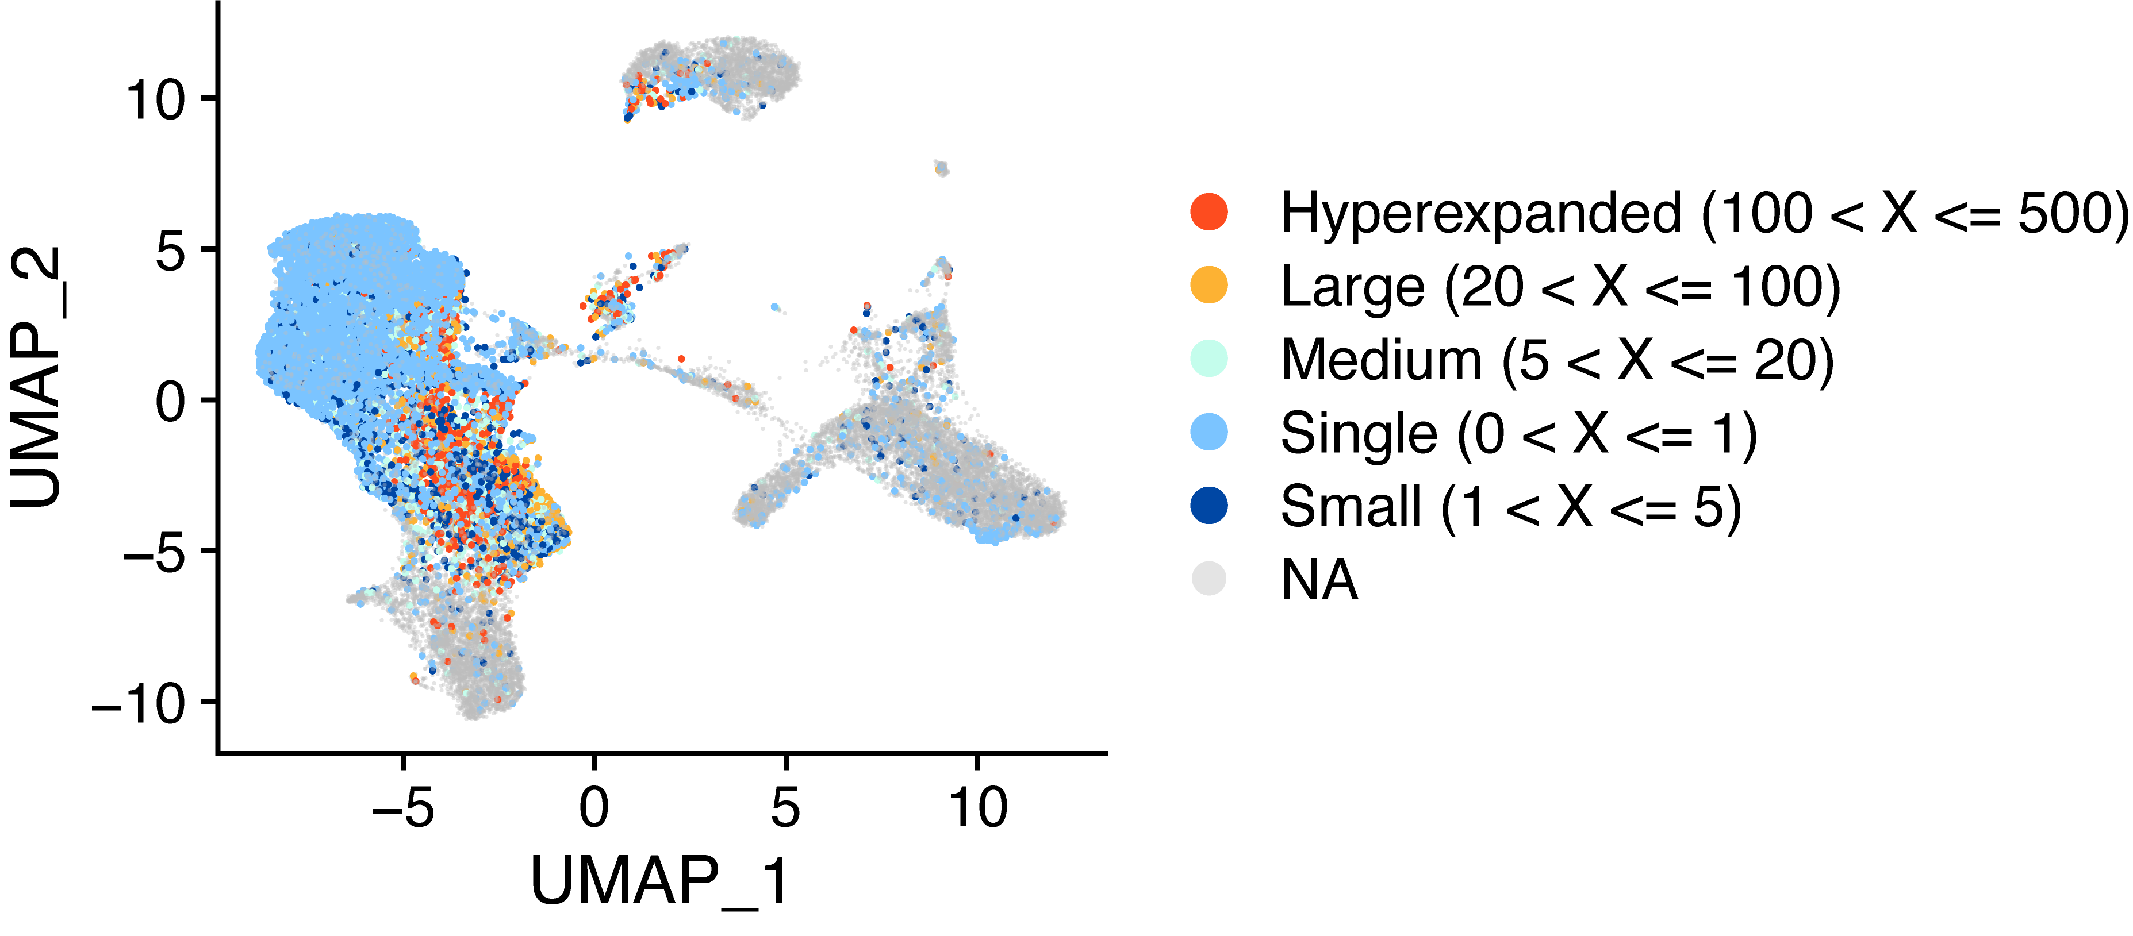
Frequency of Clonotypes Repeated

Slide 13
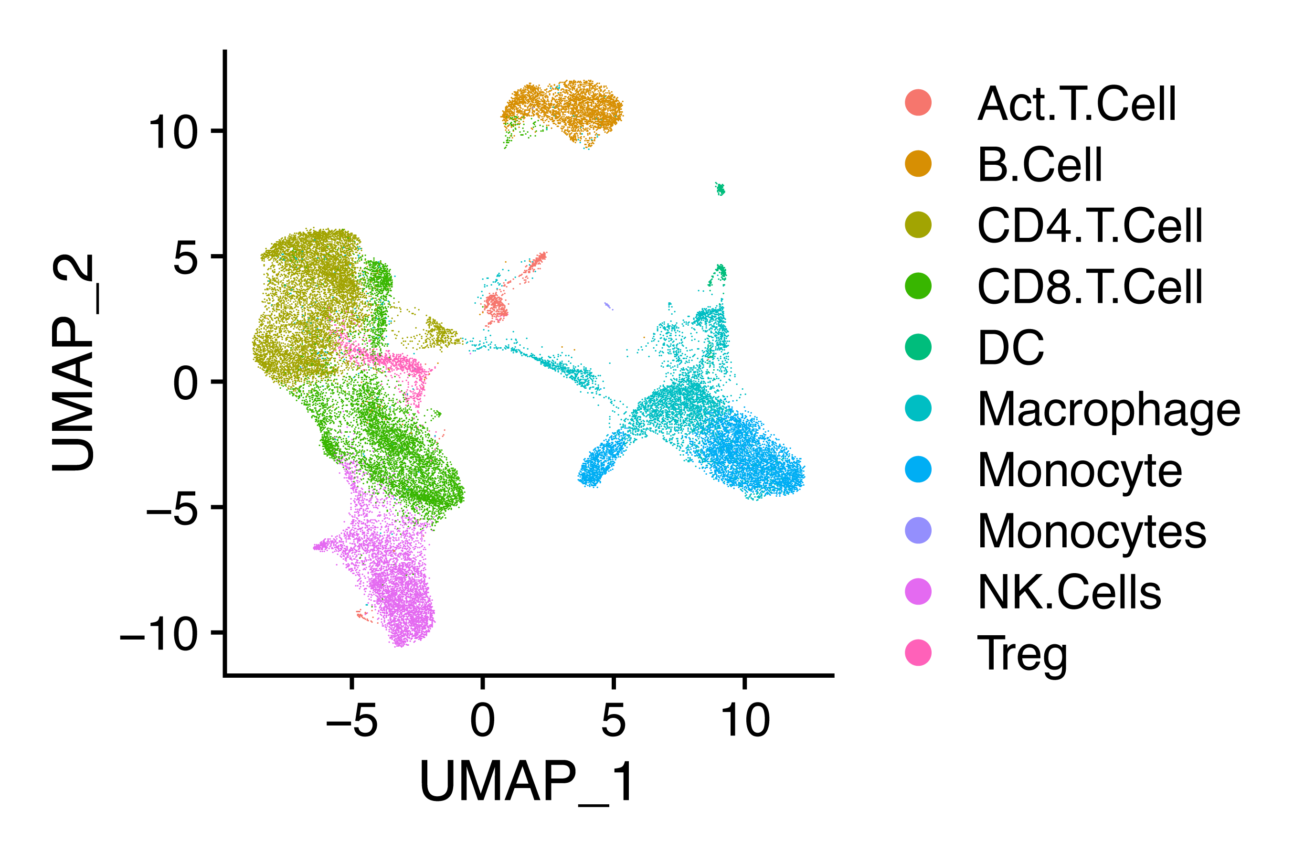
Loose Final Cell Type Assignments

Slide 14
K = Kidney Parenchyma
P = Peripheral Blood
T = Tumor
Activated APCs
Activated T cells

Slide 15
CD8⁺ T cells

Slide 16
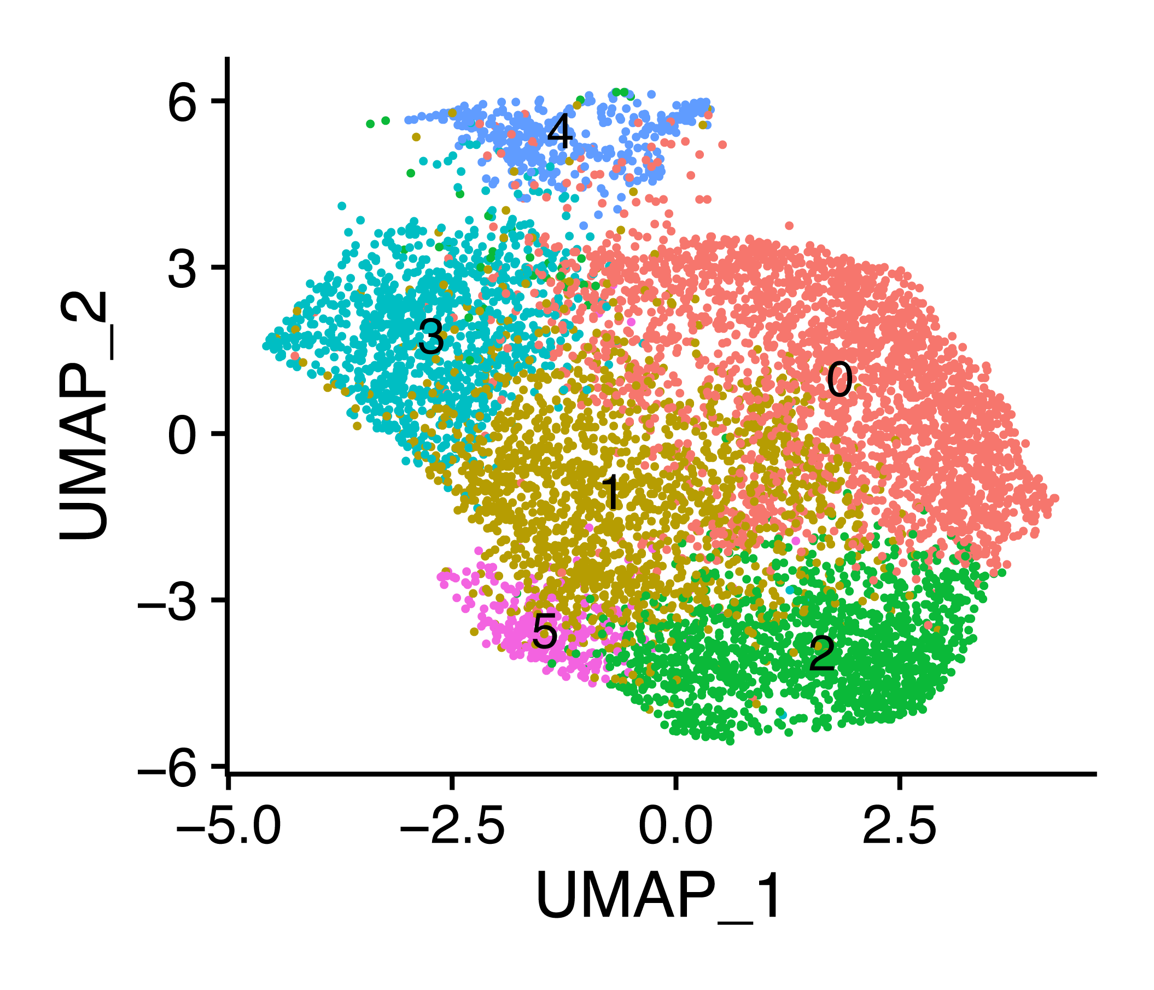

Slide 17
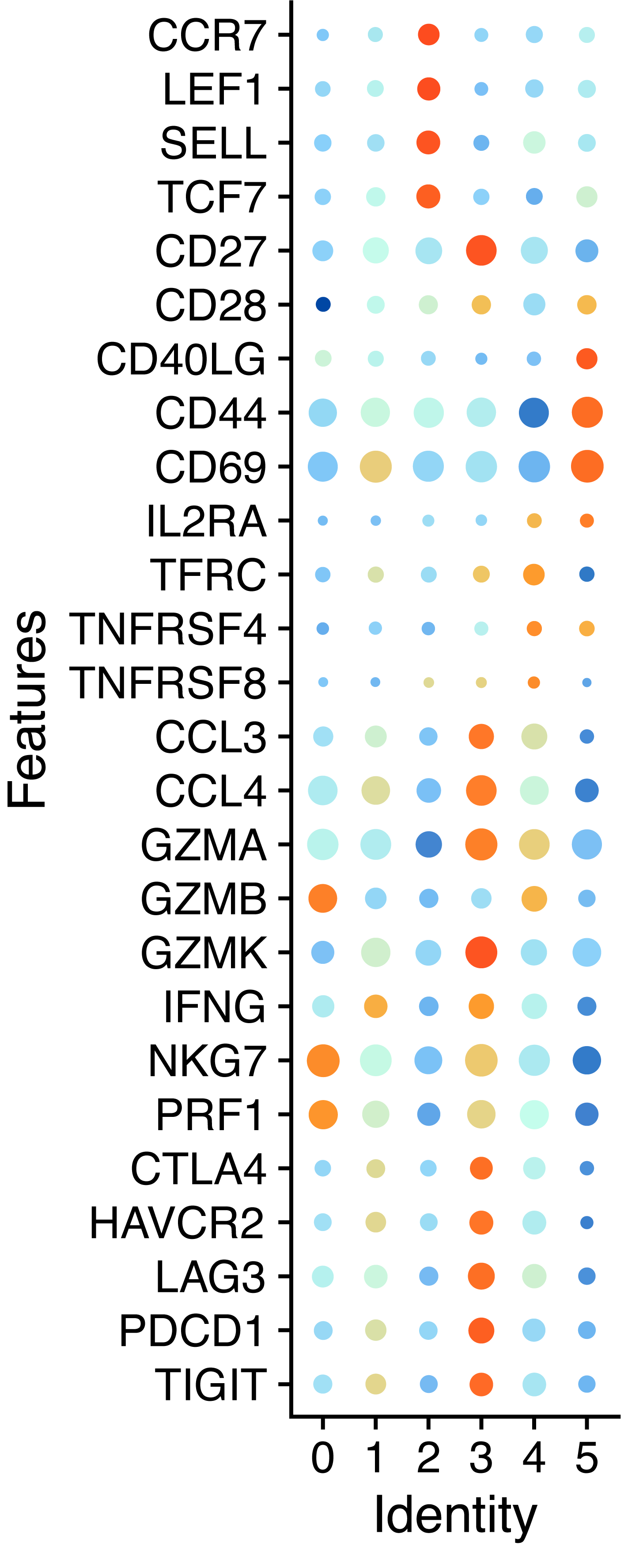
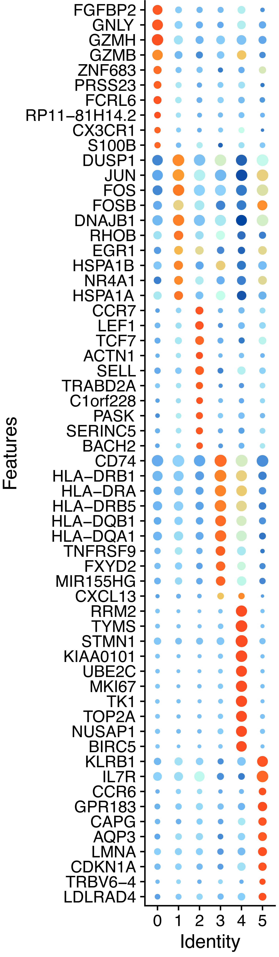
Markers by Cluster
0 Gzmb+ Effector
1 GzmB- transition
2 4 CCR7+ SELL+ TCF7+ Tcm/Naive
3 Exhausted
4. Proliferative/Activated
5. IL7R+ Tcm?

Slide 18
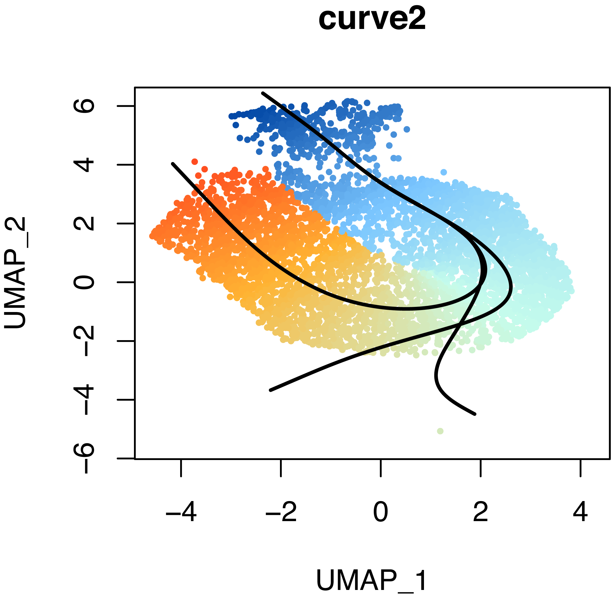
Cell Trajectory
This trajectory in particular is taking proliferative CD8+ T cells (C4), to effector (C0) to exhausted (C3)
3 distinct trajectories

Slide 19
Top genes for ordering in trajectory

Slide 20
Clonotype data
Clusters 2 and 5 have the greatest number of unique clonotypes (highest diversity)

Slide 21
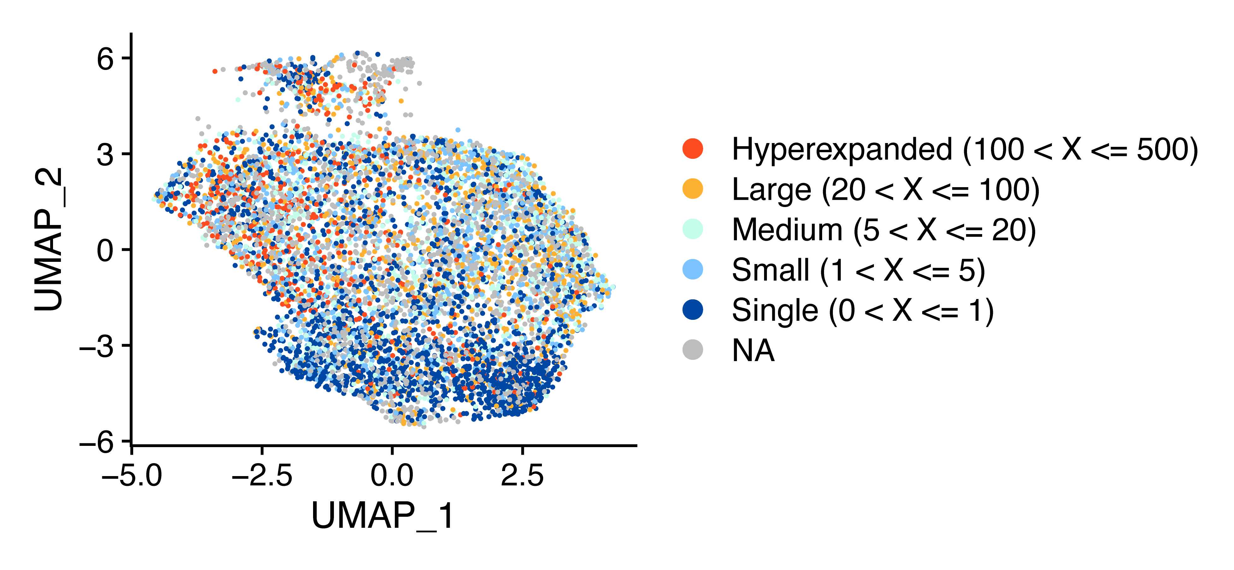
Expansion by UMAP

Slide 22
Large degree of overlap for cluster 1 → 4, 3 → 4 and 0→ 4
Clonotypic evidence of at least 1 branch of the trajectory

Slide 23
Clonotype dynamics by tissue type and cluster (tumor only)
Expanded clonotypes

Slide 24
CD8+ To Do list
Pathway Analysis
Incorporate Cluster ID, Clonotype Group, and pseudotime.
Cell Trajectory
Look at clonotype expansion across pseudotime
Find candidate markers for Mass CytOF Data

Slide 25
CD4+

Slide 26
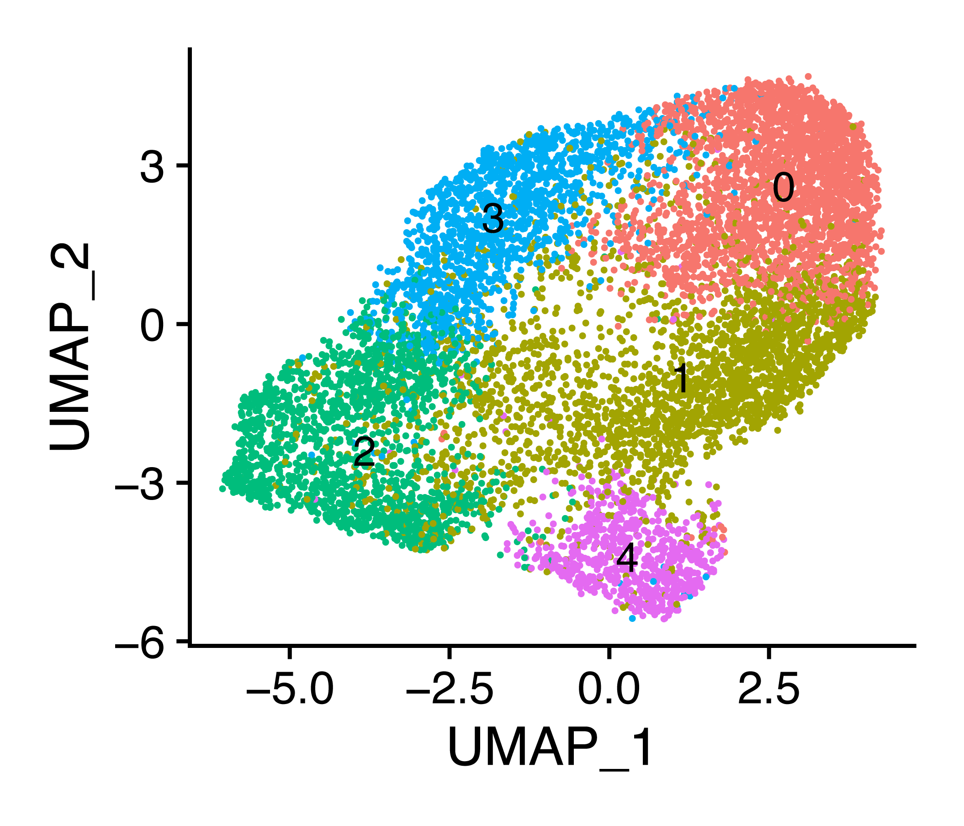

Slide 27
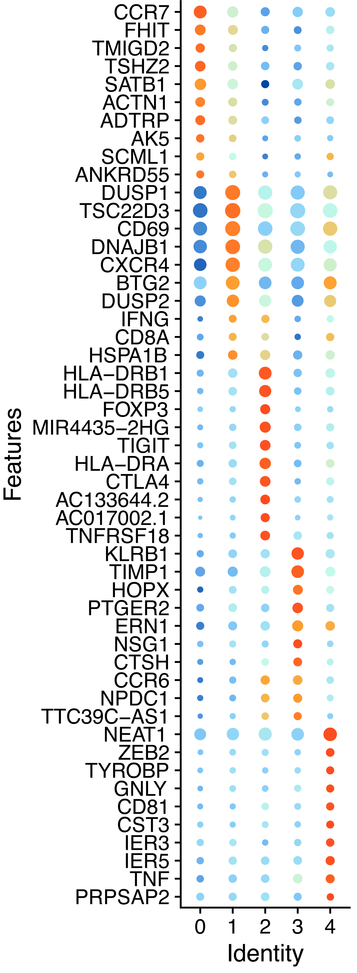
Markers by Cluster
0 CCR7+ SELL+ TCF7+ Tcm/Naïve
1 CXCR4+
2 FOXP3+/Effector TIL
3 CD44+ CD69+ Activating
4 GNLY

Slide 28
Cell Trajectory
Interesting point: Flushing out what clusters 1,2, and 4?

Slide 29
Clonotype Analysis
Conclusion: No real clonal expansion in CD4+ T cells

Slide 30
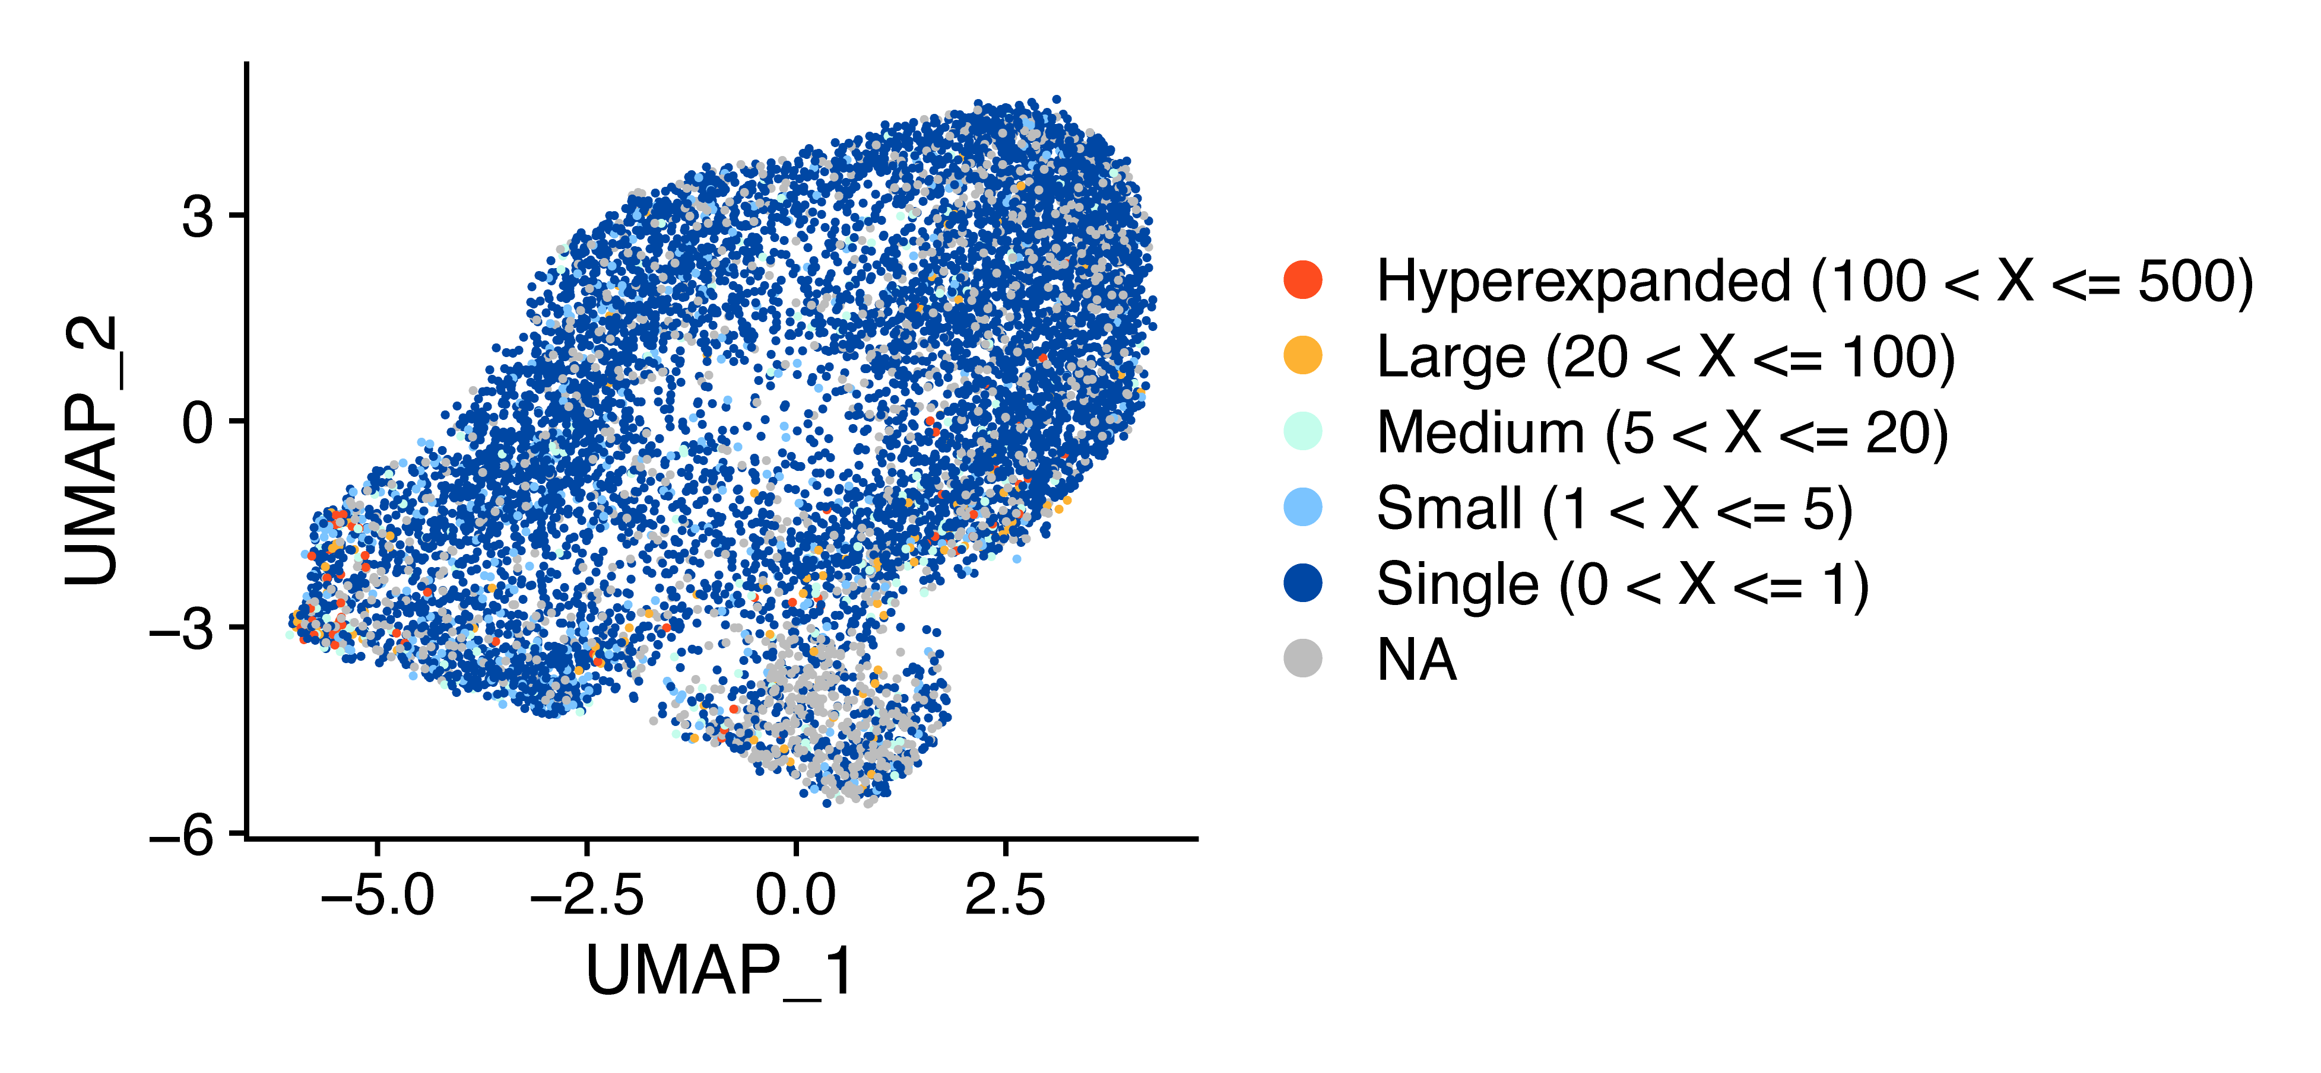

Slide 31
Interesting point: Overlap between clusters 1,2,4

Slide 32
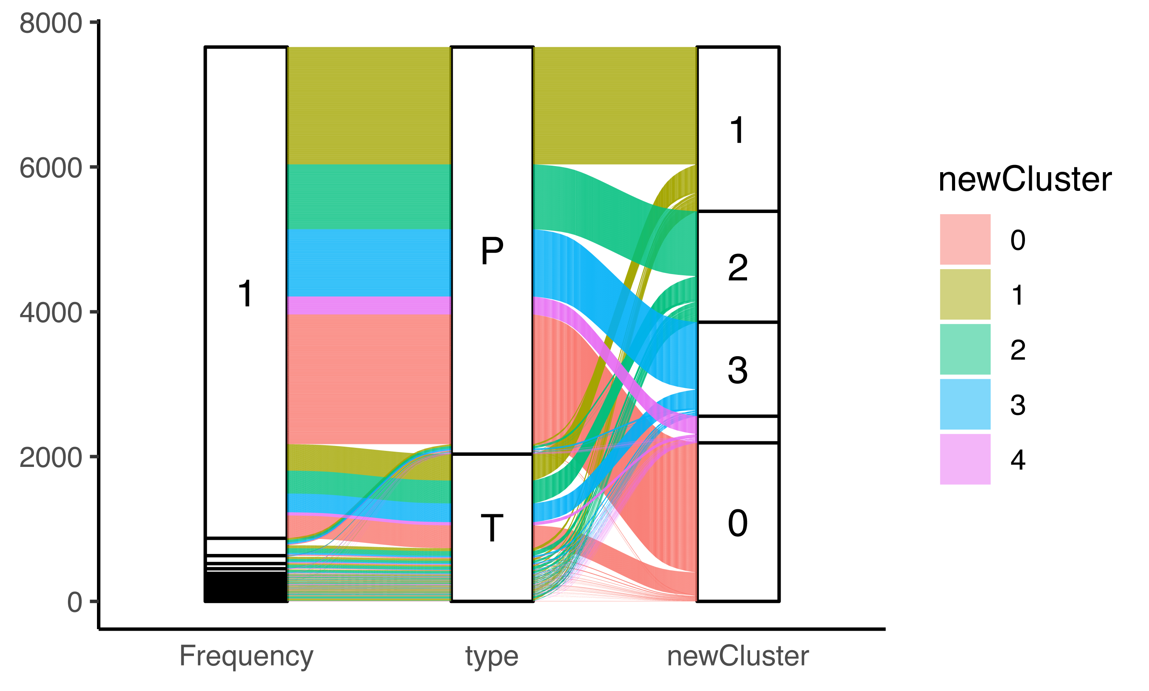

Slide 33
CD4+ To Do list
Pathway Analysis
Incorporate Cluster ID, Clonotype Group, and pseudotime.
Cell Trajectory
Differentiate Cluster 2 vs Cluster 4 branches?
Find candidate markers for Mass CytOF Data

Slide 34
APCs

Slide 35
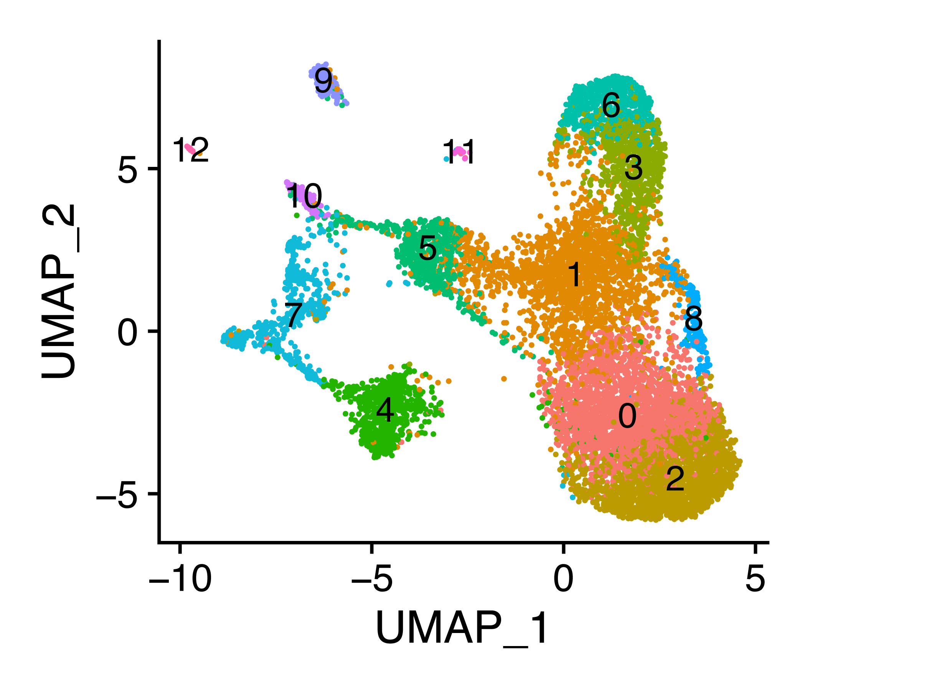

Slide 36
Myeloid Markers
CD16
CD64
CD115

Slide 37
CD141
Canonical DC
Plasmacytoid DC

Slide 38
Very Loose Assignments
C0 CD14+ Monocytes
C1 TAMs
C2 CD14+ Monocytes
C3 CD16+ Monocytes
C4 Met. Deranged APC
C5 CD207+ TR DC
C6 CD16+ Monocytes
C7 CLEC10A+ DC
C8 TAM
C9 cDC1
C10 pDC
C11 myeloid Platelets
C12 moDC

Slide 39
APC
Finalize Assignments
Perform Cell Trajectory
Pathway Analysis
Incorporate Cluster ID and pseudotime.
Find candidate markers for Mass CytOF Data

Slide 40
Points of Interest
CD8 proliferation to exhaustion trajectory
Number and diversity of professional APCs
Increased Macrophages, conDC1s, and a CD207+ DC-like cluster 5
Like Ajay originally mentioned – clonotypes expanded in the tumor are also seen in the blood

